Slide 1


President’s Report
Dr. Radenka Maric
Board of Trustees Meeting
23 September 2026

Slide 2
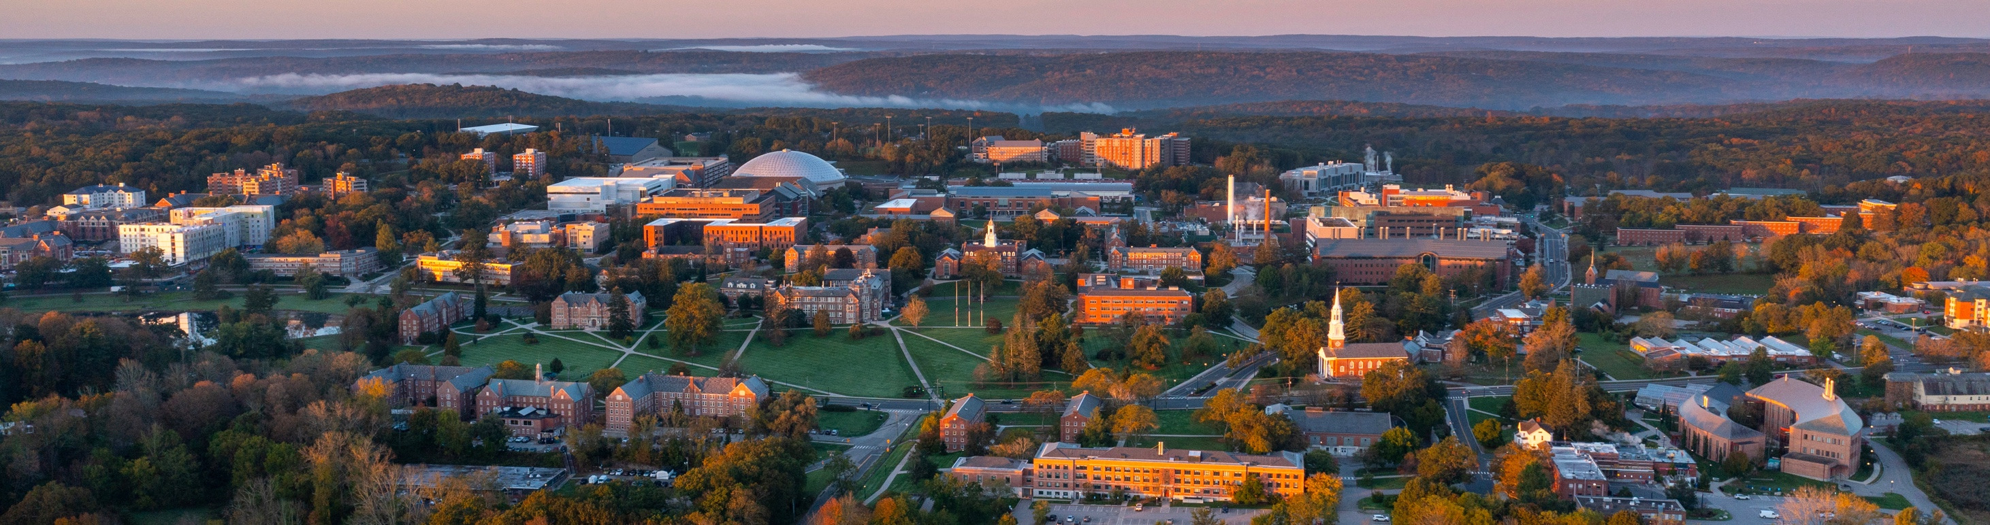
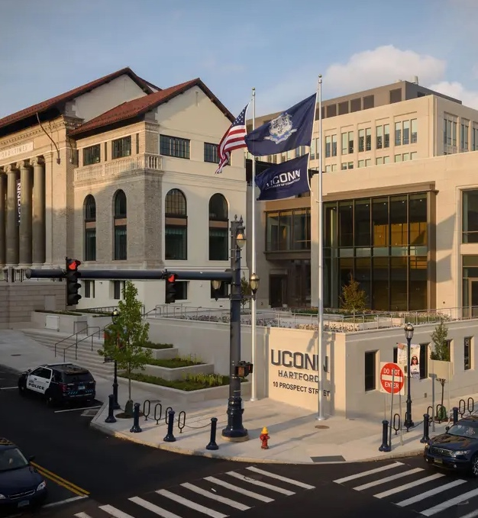
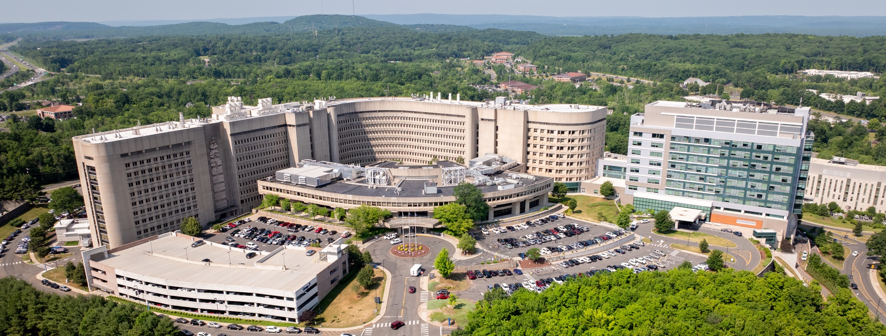

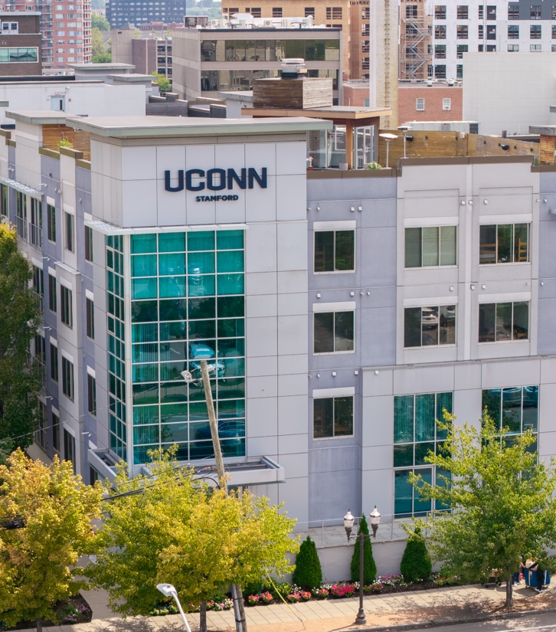
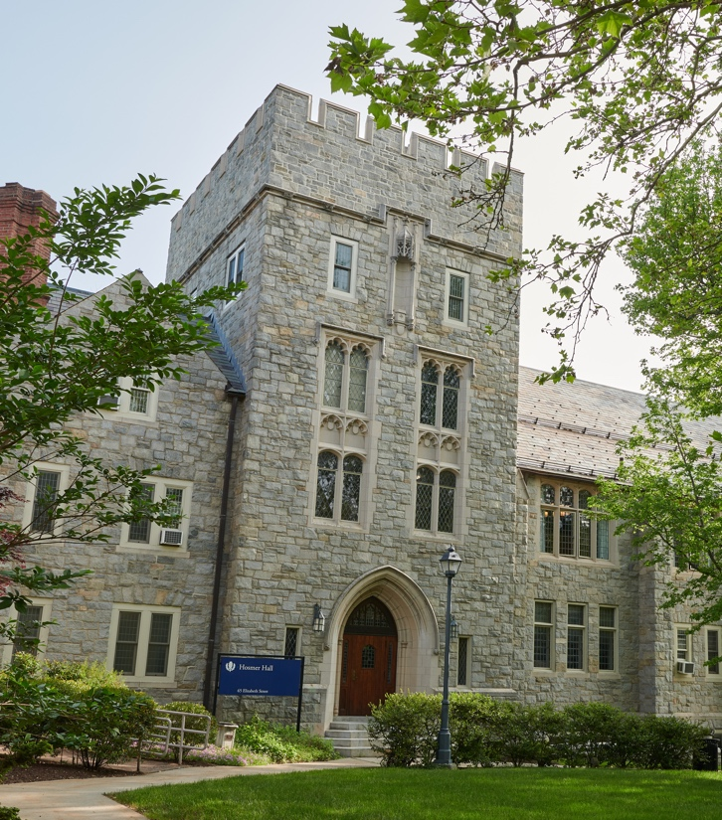
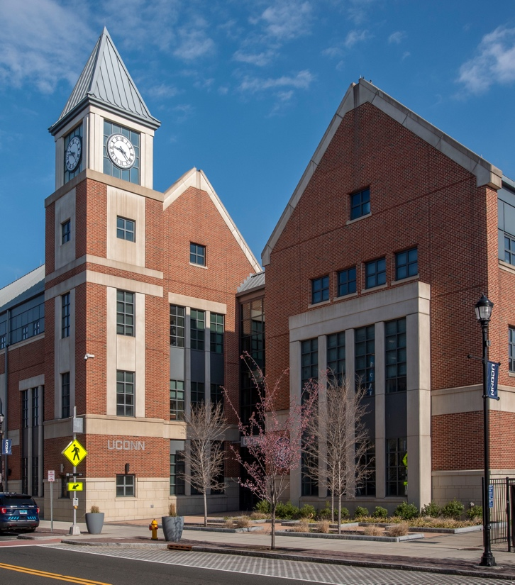

State of the University
Enrollment
Research
Philanthropy
Sustainability

Slide 3

Enrollment Summary
26,057
25,873
Total Undergraduates 2026
Total Undergraduates 2025
Total Undergraduate Enrollment
New Undergraduates
20,834
 | Fall 2025 Actual | Fall 2026 Actual
Storrs First Year | 4,663 | 4,440
Storrs Transfers | 753 | 725
Regional First Year | 1,830 | 1,940
Regional Transfers | 208 | 161
Total New Undergraduates | 7,454 | 7,266
4,977
4,860
5,144
5,039
4,984
By providing additional support and outreach, we were able to retain 600 students
who were at risk of leaving the university.
Enrollment
Notes:
2026:
Total = 4,984
Avery Point = 426
Hartford = 1,349
Stamford = 2,487
Waterbury = 722

Slide 4
Admitted Student Questionnaire
Cost, Aid, and Academic Fit are Top Priorities for Admitted Students
What this tells us
Financial factors top the list — tuition (64%) and aid (62%) outrank every campus-experience factor.
Academic fit comes next: major options (58%), teaching quality and reputation (50% each), job outcomes (46%).
“How important were the following factors in your college decision?” % selecting “Critical.” 2025.

Slide 5
Student Access and Affordability
UConn is committed to providing a high-quality education that remains accessible and affordable. Most UConn students graduate with no debt or with manageable levels of student loan debt.
In 2024–25, 91% of responding Storrs undergraduates were employed, admitted to graduate school, committed to military or volunteer service, or had started a company by the end of December following graduation.
39% of UConn undergraduates who are Connecticut residents across all campuses receive gift aid equal to or greater than the cost of tuition.
Enrollment

Slide 6

Research Update
In the past two years, universities have experienced an unprecedented level of disruption to federal funding for research
UConn Research has taken aggressive measures to soften the impacts of federal funding disruptions.
01
Ongoing challenges include rapidly changing regulations, cancellations or delays in funding, and executive orders.
State support has been critical to helping UConn respond to this crisis
02
Research

Slide 7

Selected Actions Taken in Response to
Federal Funding Disruptions
Advocate with the State to secure funds
Respond to changes impacting sponsored programs administration
Stabilize research enterprise
$35M
Research Investment Fund
Launched EMERGE internal funding program to provide investigators with emergency funding in presence of grant terminations, delays, unexpected program closures. Supported by state emergency funds
Worked with faculty to respond to federal shifts by helping them find alternate sources of funding and launched business development training workshops for faculty
Advance initiatives aligned with current federal priorities including quantum, national security, and AI.
OVPR has purposefully increased frequency and types of communication to keep all stakeholders apprised of federal shifts and our responses
$46M
Funding for Innovation Faculty Hires
We are working to prepare the University for the wide-ranging impacts of changes related to:
New federal uniform guidance
Indirect cost reimbursements
We are continuing to address grant discontinuations, reinstatements, and delays
$20M
Funding for Top Tier Faculty Hiring Initiative
Thank you!
Research

Slide 8
Research Update
UConn and UConn Health New Awards and Expenditures
FY2018-FY2026 (Preliminary)
Our aggressive response to federal volatility has allowed UConn Research to achieve a measure of stability in our current funding.
FY2025 was on track to be a growth period; instead, we are in a period of recovery.
Research

Slide 9
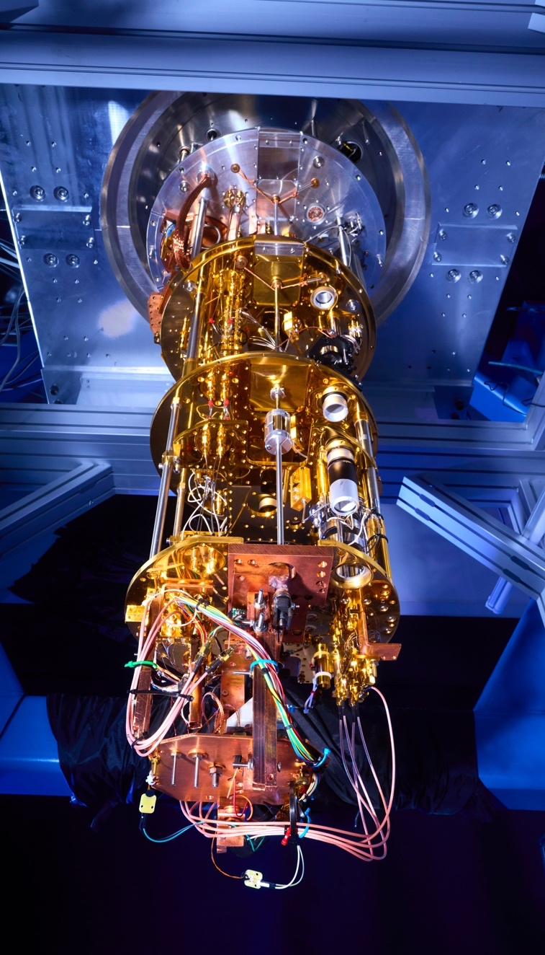

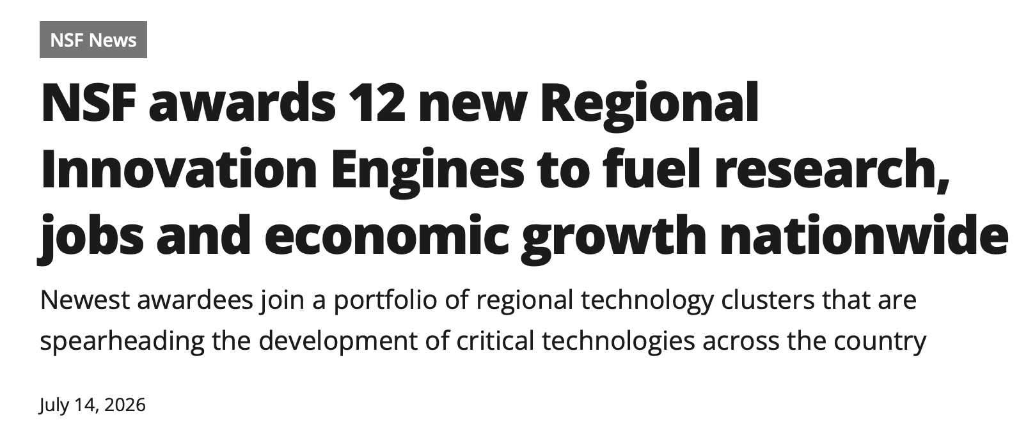
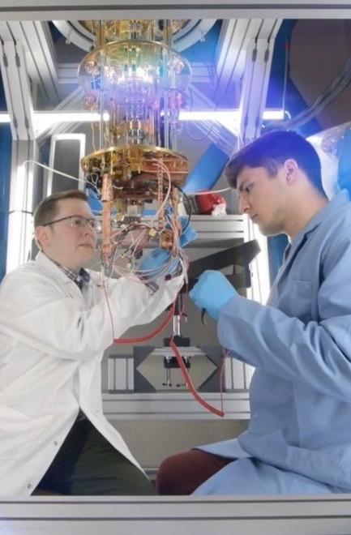
















NSF Quantum Technologies Engine in Connecticut
Engine Goals:
Build American competitiveness in quantum technologies
Transform pharmaceuticals/biotechnology, defense/aerospace, and finance/insurance sectors using quantum innovation
Proactively develop the next generation of the American workforce for quantum supremacy
Fuel the growth of a broad entrepreneurial ecosystem
Achievements to Date:
Established the statewide infrastructure and partnerships needed to secure this award
Workforce development initiatives launched, including vocational training, professional credentials/ upskillling and traditional education pathways.
Applied research projects conducted that connect industry with university researchers
Secured $121M commitment from the State for quantum infrastructure in support of QuantumCT
NSF Engine Partners

Slide 10

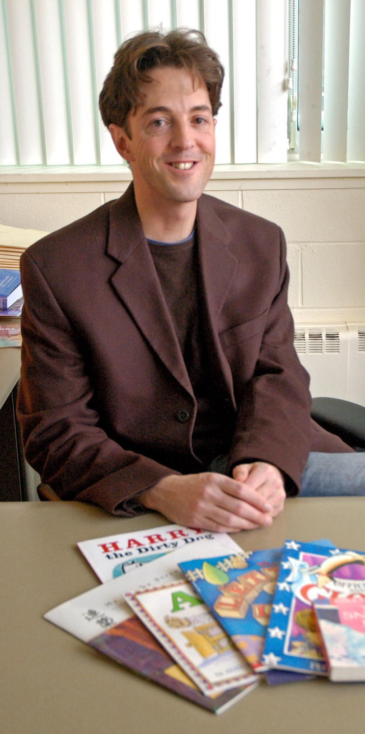

Major Research Awards
Genesis Mission Award
AI-Enabled Digital Twin Framework for Coupled Surface–Subsurface Hydrologic and Biogeochemical Simulation in the Northeast U.S. Coastal Region.
PI: Wei Ren
Funding Agency: US Department of Energy
Awarded amount: $525,000
The project will build an AI-powered ‘digital twin’ of the Northeast U.S.—a virtual replica that combines satellite observations, field measurements, and state-of-the-art numerical models to reveal how water and chemicals move above and below the ground.
K-3 Literacy Support
PI: Michael Coyne
Co-PI: Brandi Simonsen
Funding Agency : US Dept. of Education
Prime recipient: CT State Dept. of Education.
Amount to State of CT: $10M
Subaward to UConn: $4,313,899
This grant will help schools enhance targeted reading interventions and integrated positive behavioral supports. It builds on more than a decade of collaboration among CSDE, UConn, districts, schools, and partners through the Connecticut Literacy Model, while also aligning with Connecticut’s Multi-Tiered System of Support framework
The Genesis Mission unites DOE National Labs, industry, academia, and more to harness AI for breakthroughs in energy dominance, discovery science, and national security.
Research

Slide 11
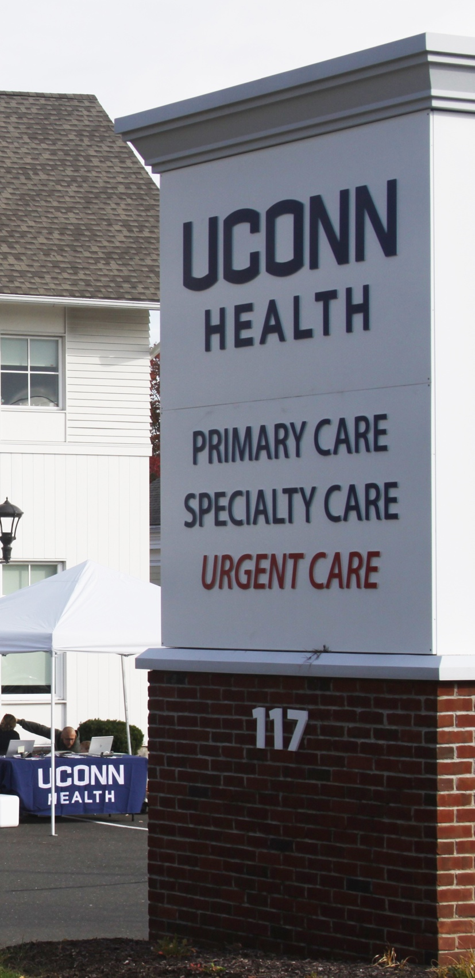
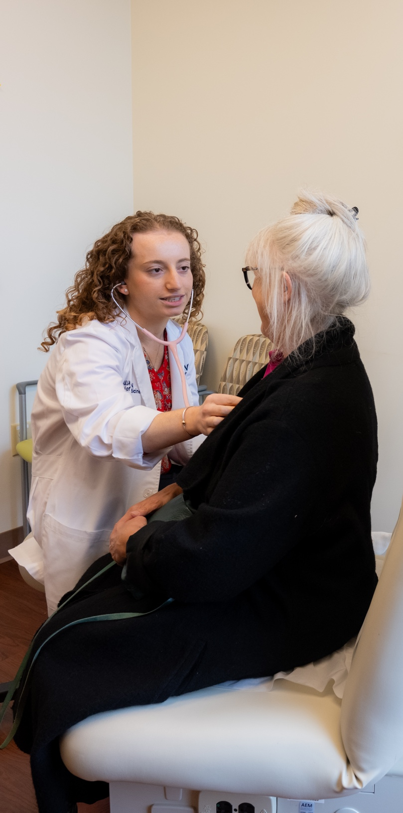

Major Awards at UConn Health
Connecticut Rural Health Transformation Program
PI: Petra Clark-Dufner
Funding Agency: State Dept. of Public Health
Awarded amount: $37,400,000 for 8/1/26 – 6/30/31 (approx. $7.5M per year)
UConn is the coordinator for The Rural Provider Incentive Program (RPI Program), a core component of the CT Rural Health Transformation Grant Program, which is designed to incentivize medical providers to provide long term Primary Care and Behavioral Health services in Rural Towns.
Claude D. Pepper Older Americans Independence Center
PI: George Kuchel and Richard Fortinsky (Multi-PIs)
Funding Agency : NIH/National Institute on Aging
Amount: $6,579,883 for the period 9/1/26 – 8/31/31
This renewed award supports the Claude D Pepper Older Americans Independence Center at UConn (UConn OAIC). UConn’s Pepper Center is one of 16 centers nationwide designed to increase scientific knowledge that allows older adults to maintain or restore their independence.
Research

Slide 12
Philanthropy
Because of UConn Campaign
A RECORD YEAR
FY 26 In Review: UConn Foundation
raised to date
$933.5M to $1.5B Goal
$51.3M
$171M+
$120M+
Athletics achieved a second record-breaking year with $51.3M.
Unique donor count: $70K toward $100K goal
Raised $171M+, strongest fundraising year in history.
Raised $120M+ in cash - over $20M ahead of FY25.
$38M+
$38M+ for Health Sciences and Medical - a 163% increase.
ADDITIONAL FY26 RESULTS
$1M+ engagement instances toward $1.2M goal
$28M
$28M for UConn Health – 152% increase over FY25.
$748M
Grew endowment to $748M – nearly 12% growth over FY25.
98%+
Reached over 98% of contactable alumni.
$7.1M
UConn Gives raised $7.1M from 4,876 donors—up 31% and 500 donors over FY25.
Record 33 donors giving $1M+, includes six $5M+ gifts
Philanthropy

Slide 13
Foundation Fundraising
FY Raise, FY20-27 YTD
$18,188,422
Annual fundraising totals
$165M
(Goal)
FY27 Q1 Highlights
$7.1M ahead of 3YA
$18,188,422*
Robust pipeline across all giving levels.
$7.1M ahead of 3YA
*As of 9/18/26
Robust pipeline across all giving levels.
20%
increase in gifts $10K+ over FY26
69%
increase in gifts $10k+ over 3YA
Philanthropy

Slide 14
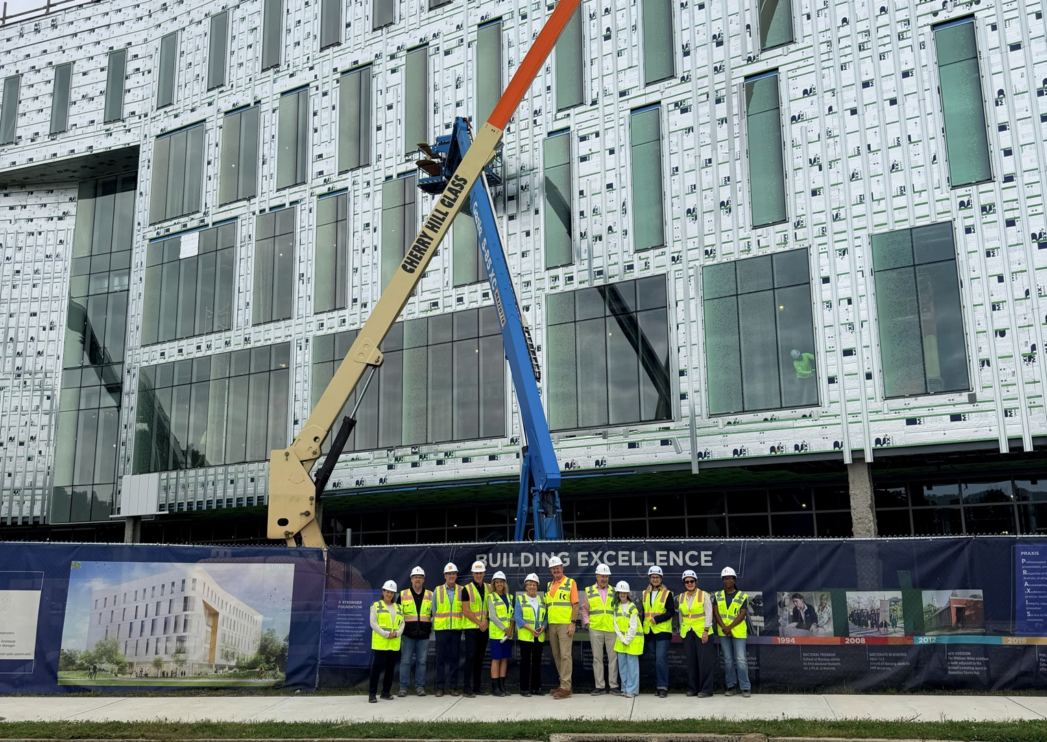
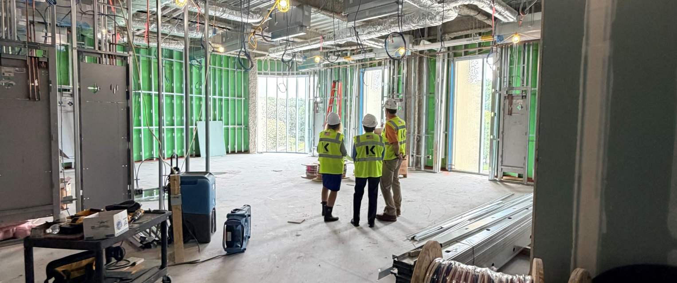
Elisabeth DeLuca School of Nursing
Opening January 2027
Elisabeth DeLuca ’69 (NUR), ’26 H
Advancing the Future of Nursing Education
2×
297
426
The Elisabeth DeLuca School of Nursing has doubled its enrollment in less than 10 years
The 2026-2027 incoming nursing freshman class is the largest in its history with 275 in Storrs, 22 in Waterbury
degrees awarded in 2025-2026
$4.9M
in scholarships awarded to-date
A UConn experience has been made possible for nearly 530 students
DONOR INVESTMENT
WATERBURY PATHWAYS
An additional $2.4M (and growing…) has been raised from donors to support DeLuca Hall
Expansion to UConn Waterbury has created additional nursing & STEM pathways for students.
A $1.65M match is targeted for Waterbury STEM initiatives
Philanthropy

Slide 15
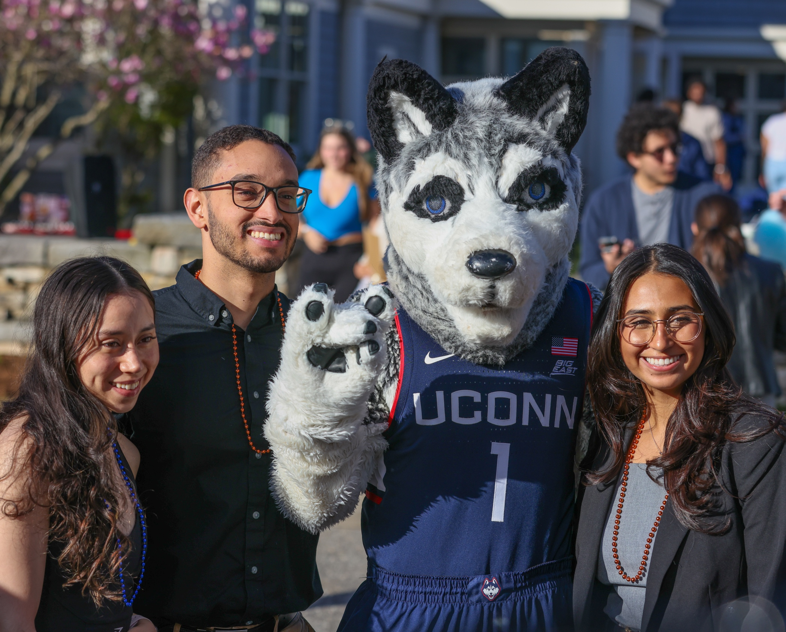
Campaign Focus: Students First Fund
FY26
$730K
raised in outright gifts and commitments
FY25: $67K raised in outright gifts and commitments
SPRING 2026
Over $38K issued for Spring 2026
2024 – 2025 awarded $49K for entire academic year
Average award size doubled
930% increase in funding for student emergency needs
Donor support enabled us to double the average amount provided to assist students facing unexpected financial hardship in 2026 compared with 2025.
Philanthropy

Slide 16
UConn is a World Leader in Sustainability
UI GreenMetric's World University Rankings
CT DEEP GreenerGov Awards
2026 Planetary Health Report Card
8th
Sustainability Achievement Award
A-
1 of 7 US Medical Schools rated A-
Most Sustainable
Most Electric Vehicle Chargers Installed
Improved from 10th place in 2024
Peer of UC Davis
UCH Farmington Creative Child Center HVAC Retrofit
Trailblazer Award
50% Reduction of volatile anesthesia gas
Connecticut Innovations Partnership Grant
AASHE STARS
51%
energy use reduction saving 46,000 kWh
UConn rated
Eco Champion Award
Gold
Top Performer
Facilities and Office of Sustainability
Staff Recognition
Sustainability

Slide 17
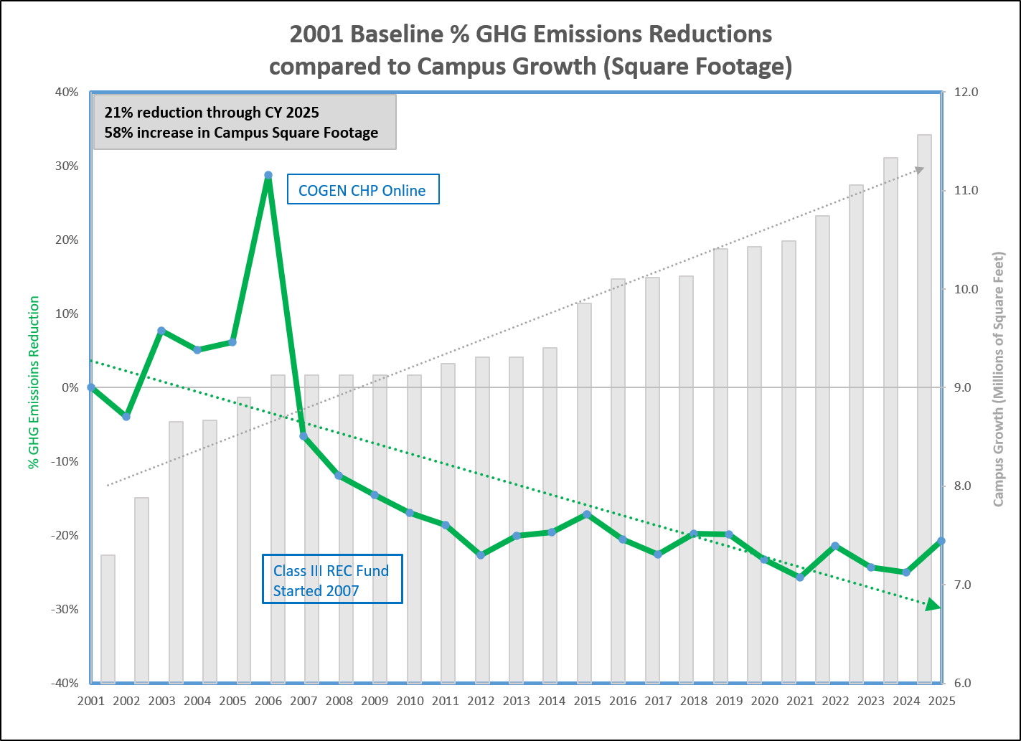
Progress Toward Sustainability
UConn has reduced emissions by >21% since 2001 even though the size of our campus has expanded by 58%
Recent infrastructure improvements to reduce emissions include:
COGEN turbine modifications, completed May 2026 resulted in:
  15% increase in energy generation
  4.5% reduction in emissions
  Hydrogen-ready. Turbine is capable of running 30% on clean hydrogen
Putnam 1.0 MW Fuel Cell commissioning 2026-Q3 will produce 920kW for campus distribution network and heat for Putnam kitchen and building boilers.
  These improvements are expected to offset slight rise in emissions indicated on graph.
Sustainability

Slide 18
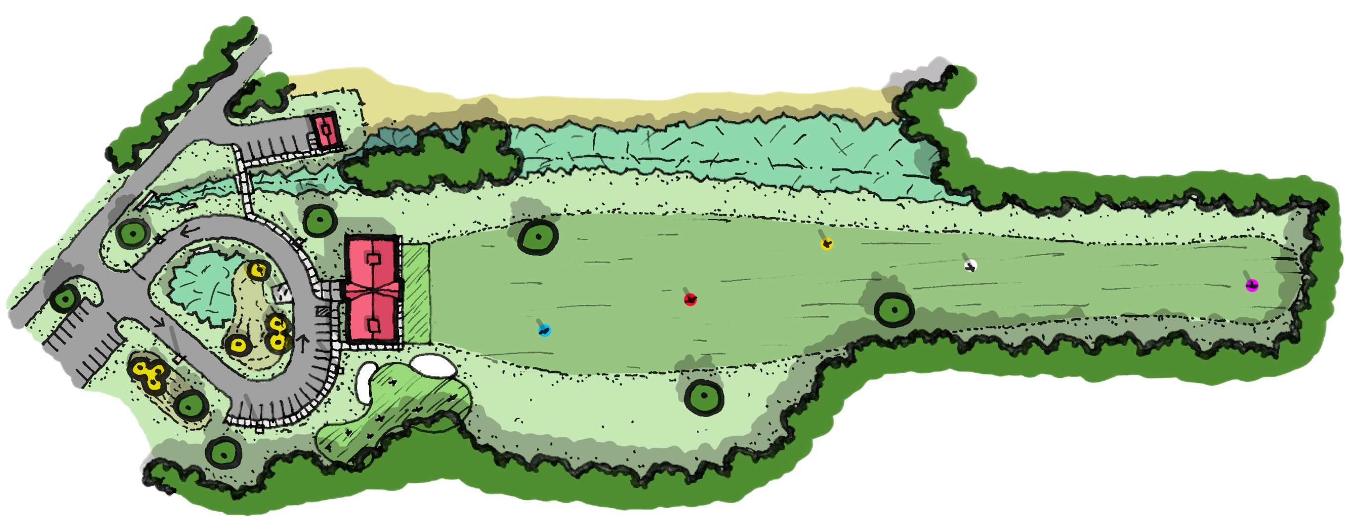
Golf Practice Facility Update
Development site moved from Storrs/East Road location to Weaver Road on Depot Campus
Recently-planned building demolitions, direct access to UConn utilities, and less clearing and earthwork needed, made the Weaver Road site a better candidate.
Design program mostly unchanged.
Timeline
Current: Design and engineering underway
Sept. 8- Oct. 9: CT EPA Public Scoping and Public comment period ends
Spring 2027-2028: Construction
Sustainability

Slide 19
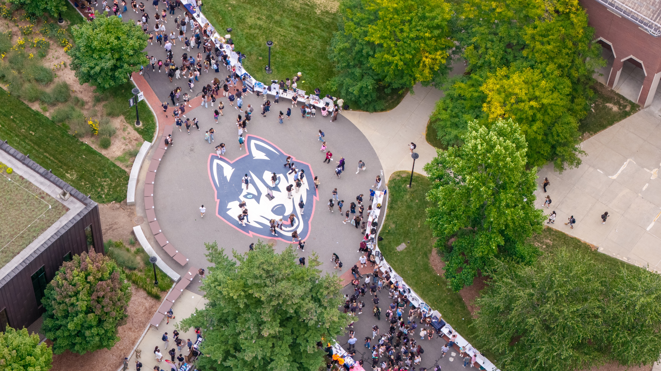
Thank you!

