Slide 1

UConn 4-H
Connecticut's Pathway to UConn
UConn Board of Trustees
September 23, 2026

Slide 2

Enduring Statewide Impact
UConn 4-H has been the first personal experience with UConn for generations of Connecticut residents.

Slide 3
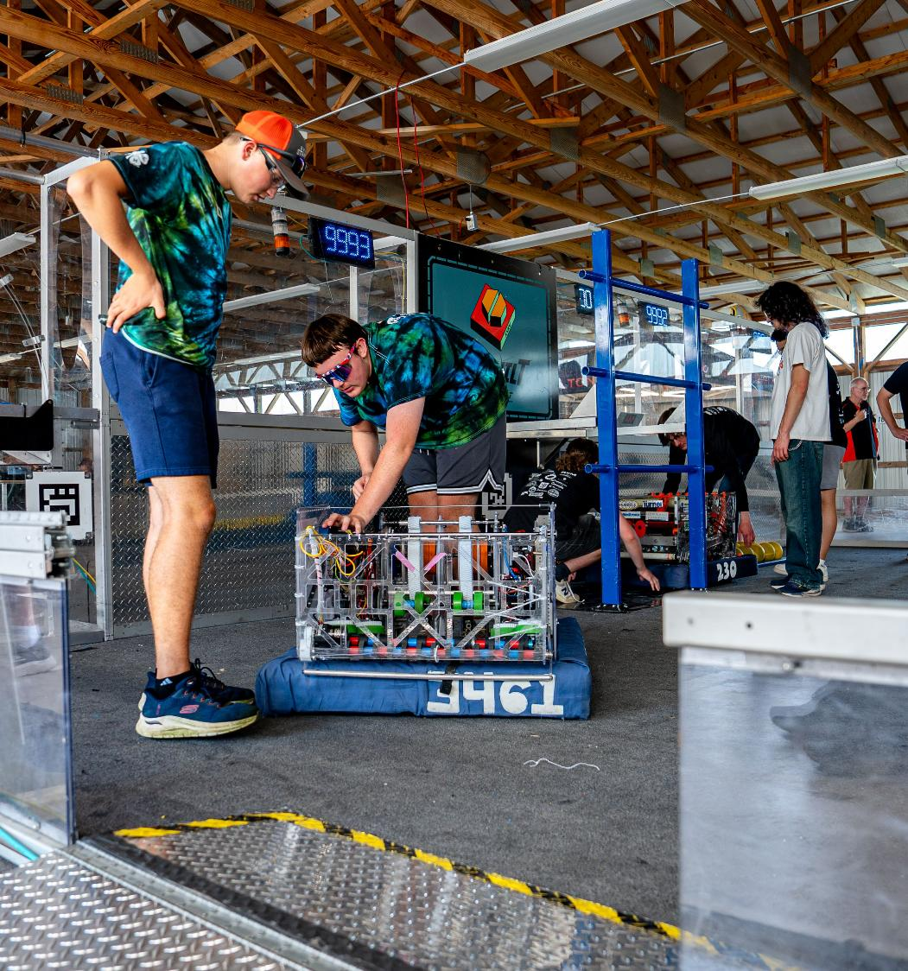
Fostering Future Leaders
Hands-on experiences in a variety of career areas opens doors for Connecticut youth.

Slide 4
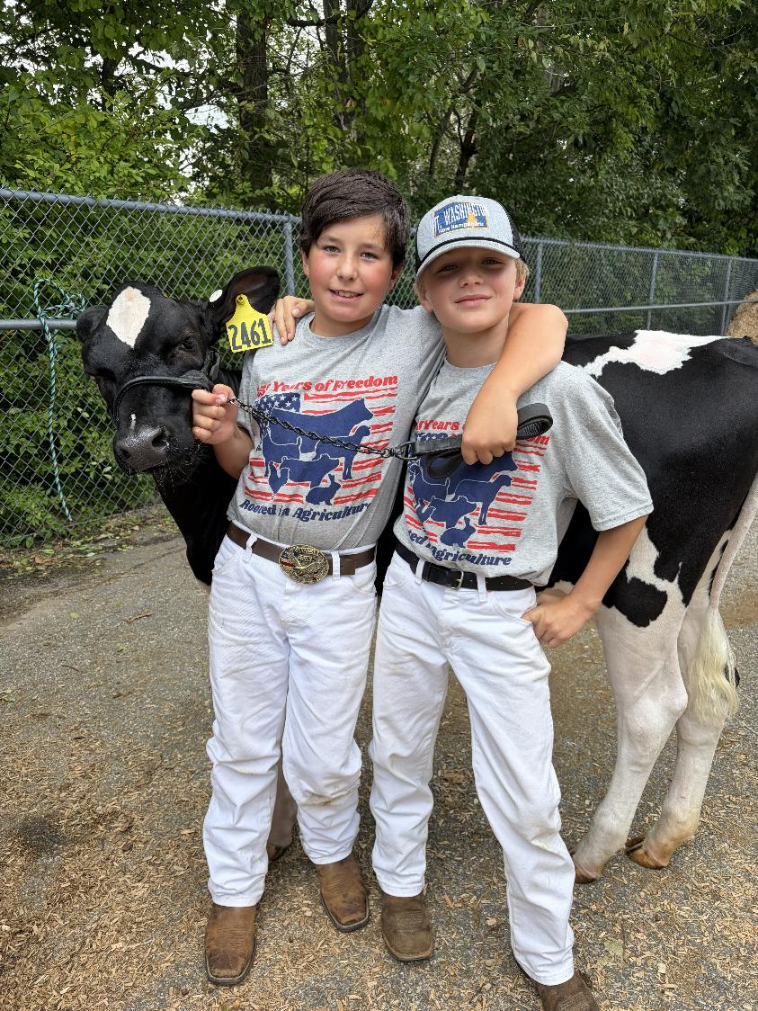
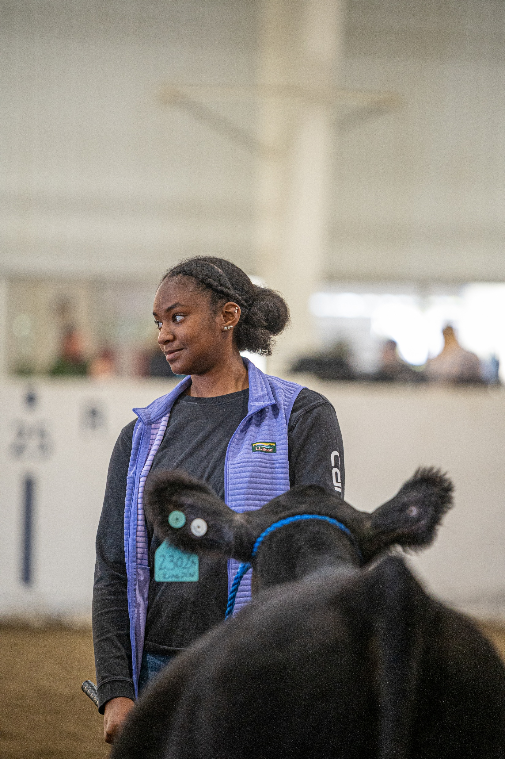
The UConn 4-H Journey
Tahlia Watson ’29
Animal Science
Alex Hermonot, 11
Emmet Salvas, 10

Slide 5

Happy Herdsmen
Alex Hermonot, 11
Emmet Salvas, 10

Slide 6
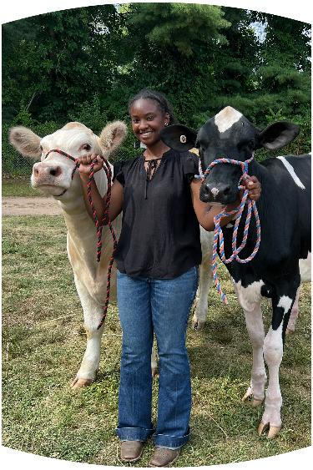
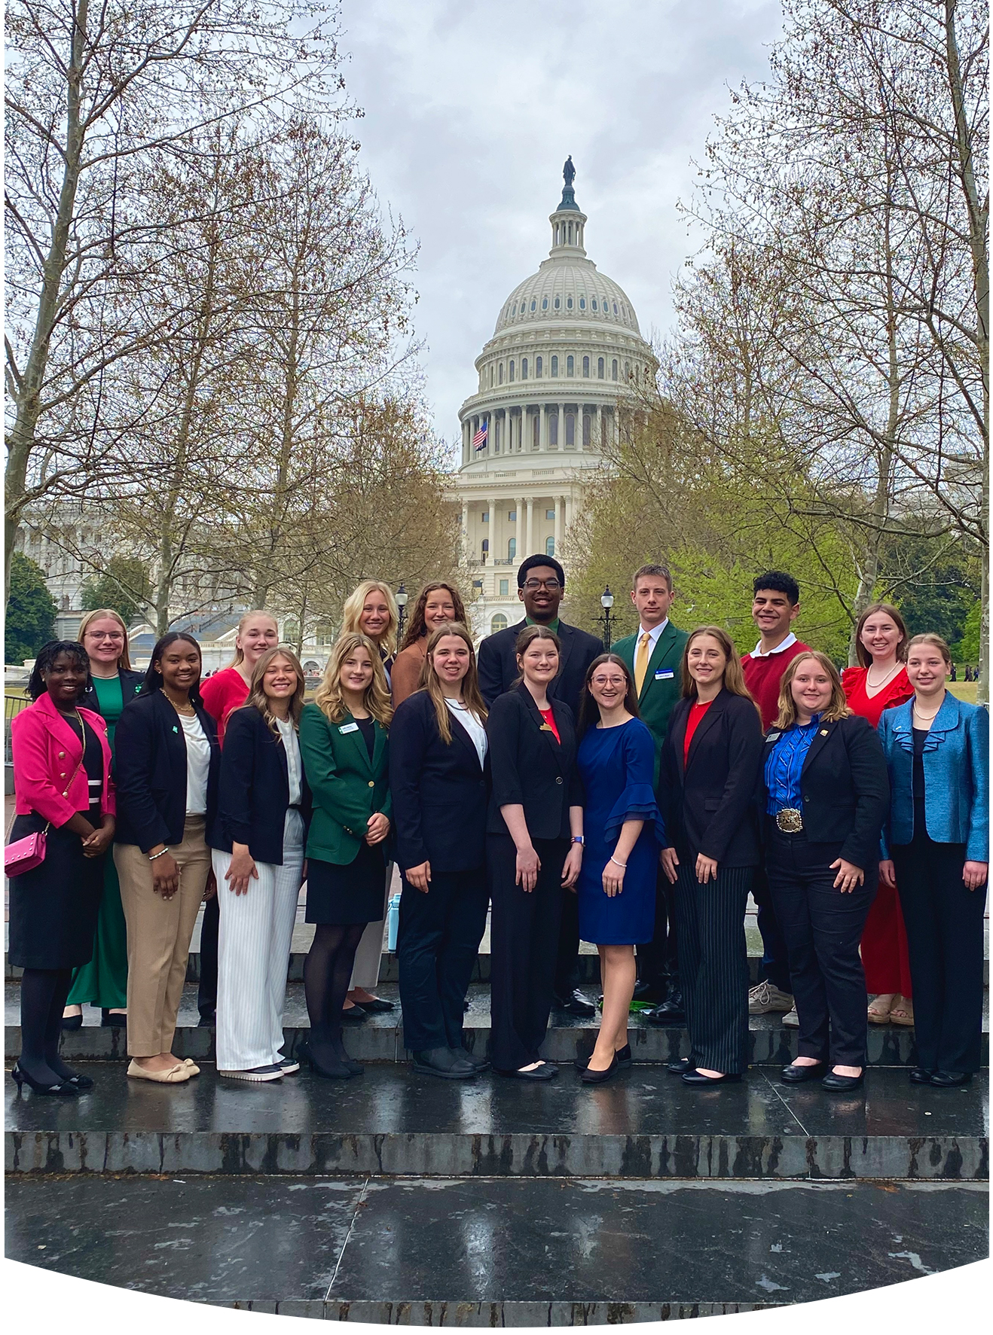
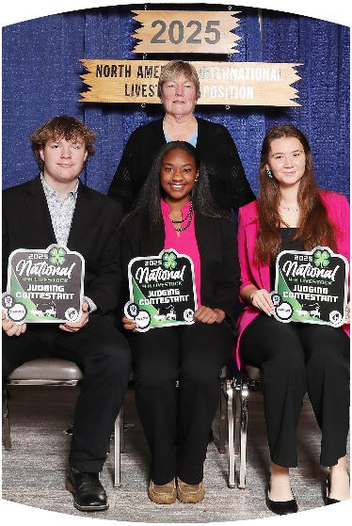

Tahlia Watson
Learning the value of persistence and “making the best better.”

Slide 7

UConn 4-H: Here for Connecticut

Slide 8
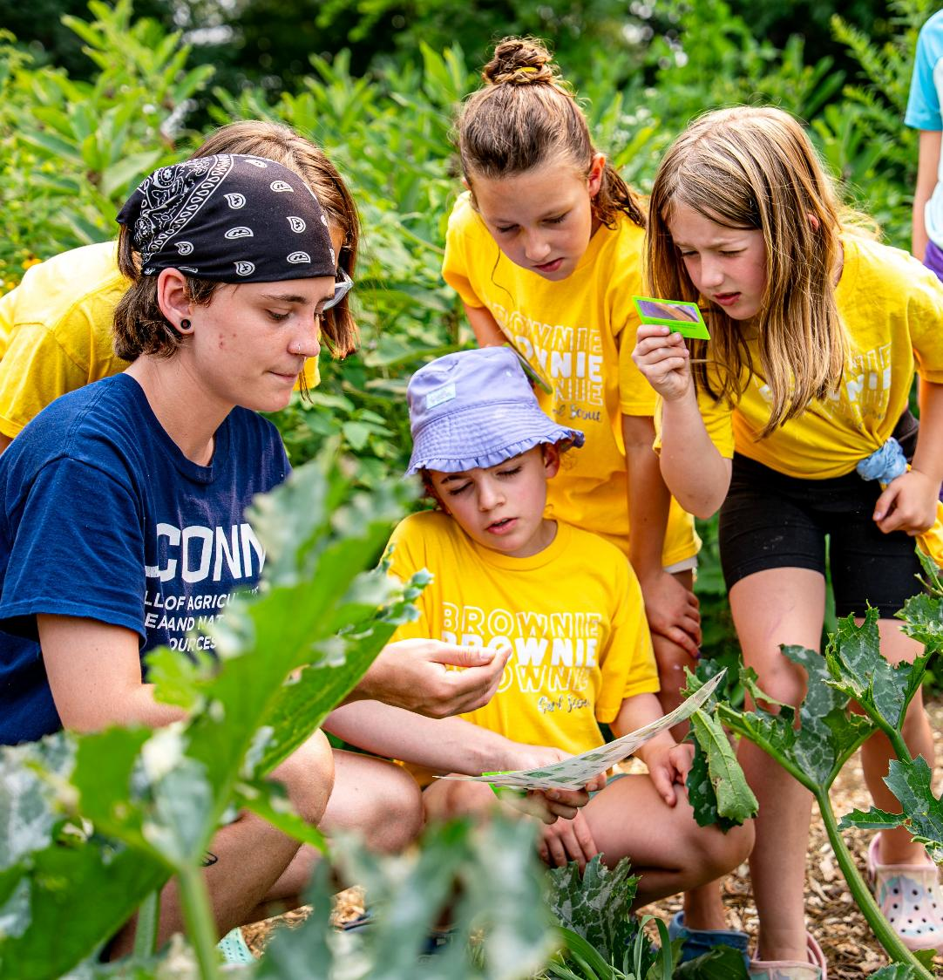
Serving Connecticut Youth
Over 29,000 youth across 166 Connecticut towns participate in UConn 4-H programming.

Slide 9



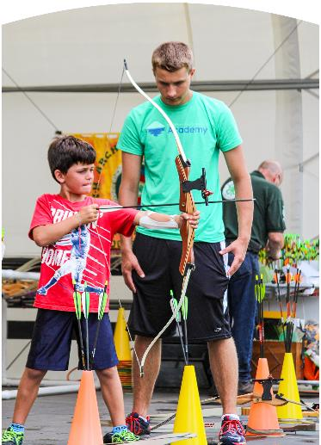
Beyond Ready for a Bright Future
70% of 4-H teens feel prepared to apply technical and life skills in their careers.

Slide 10
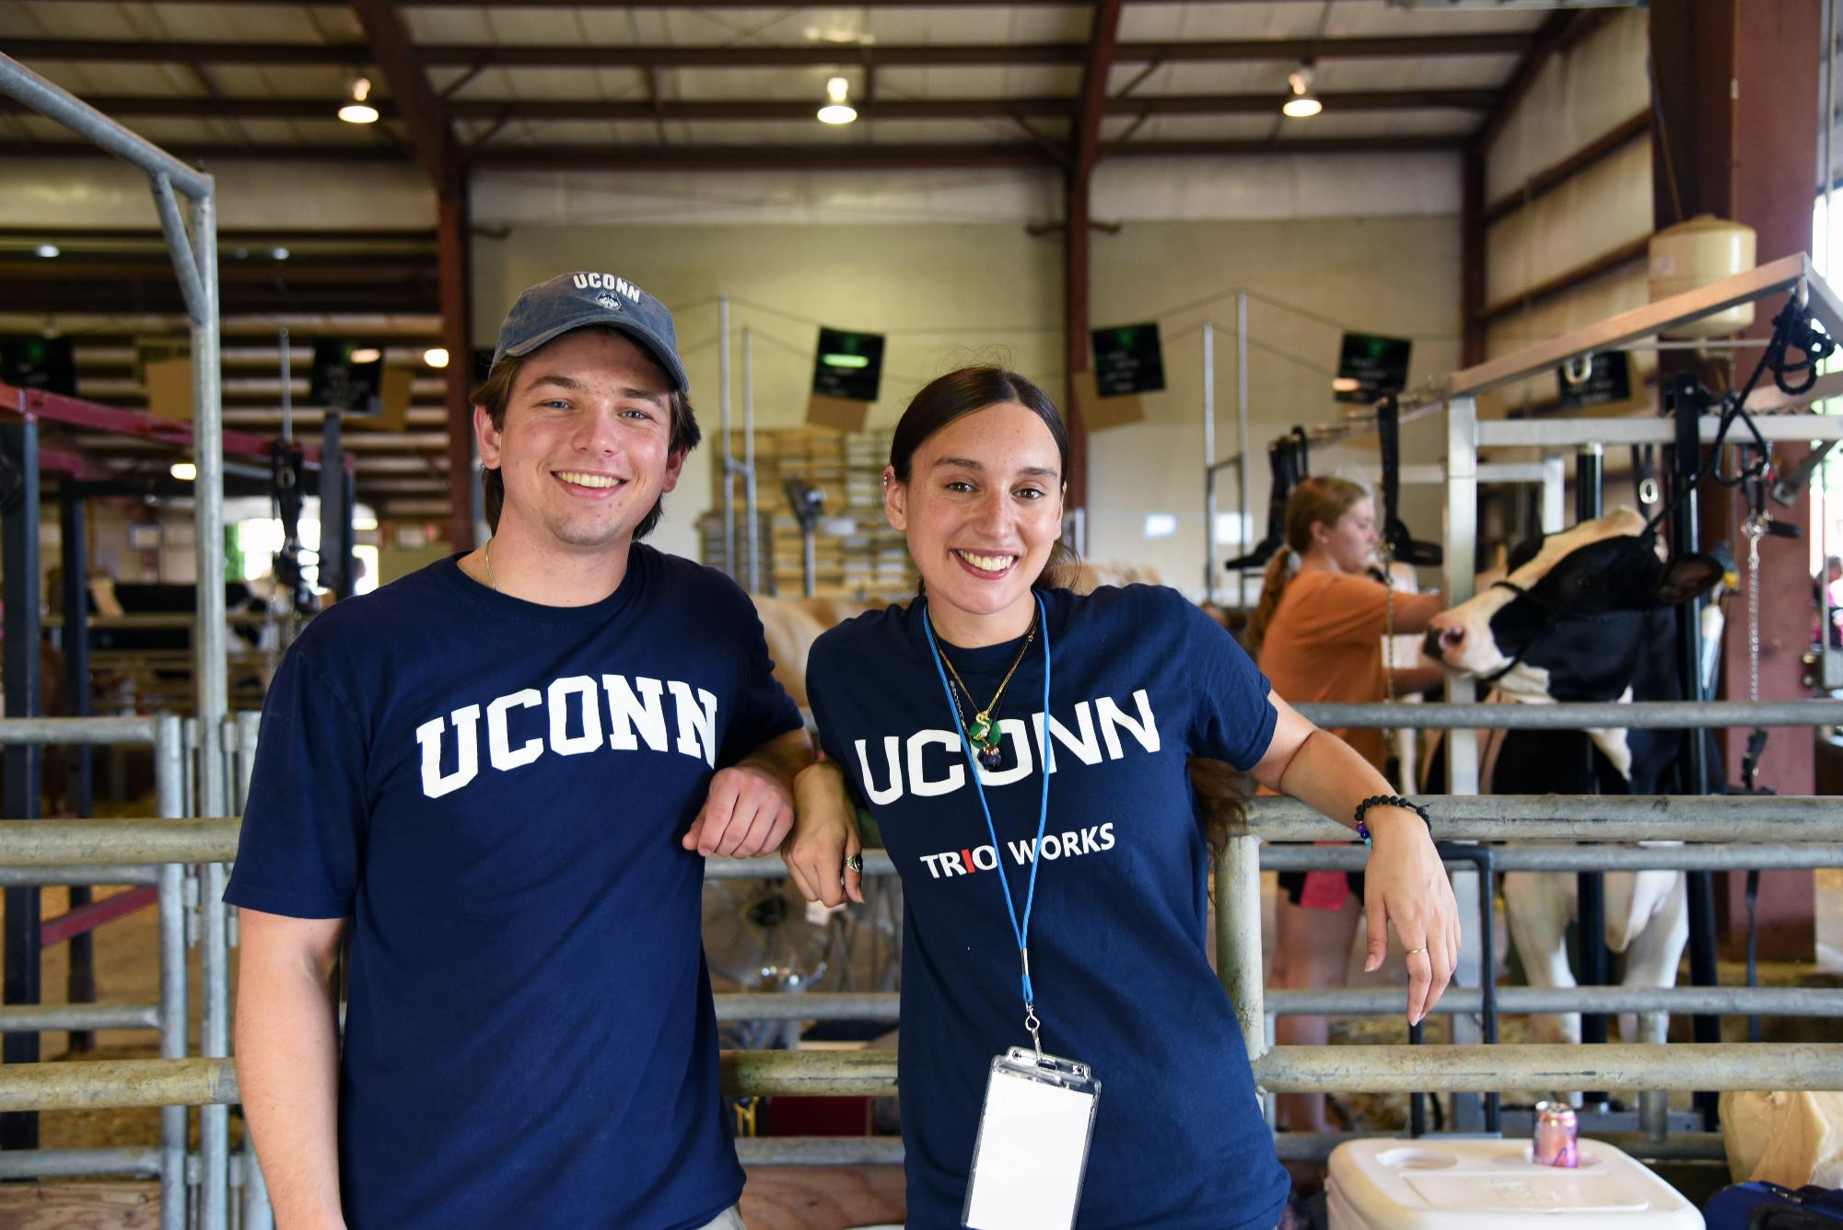
Opening the Door to UConn

