Slide 1
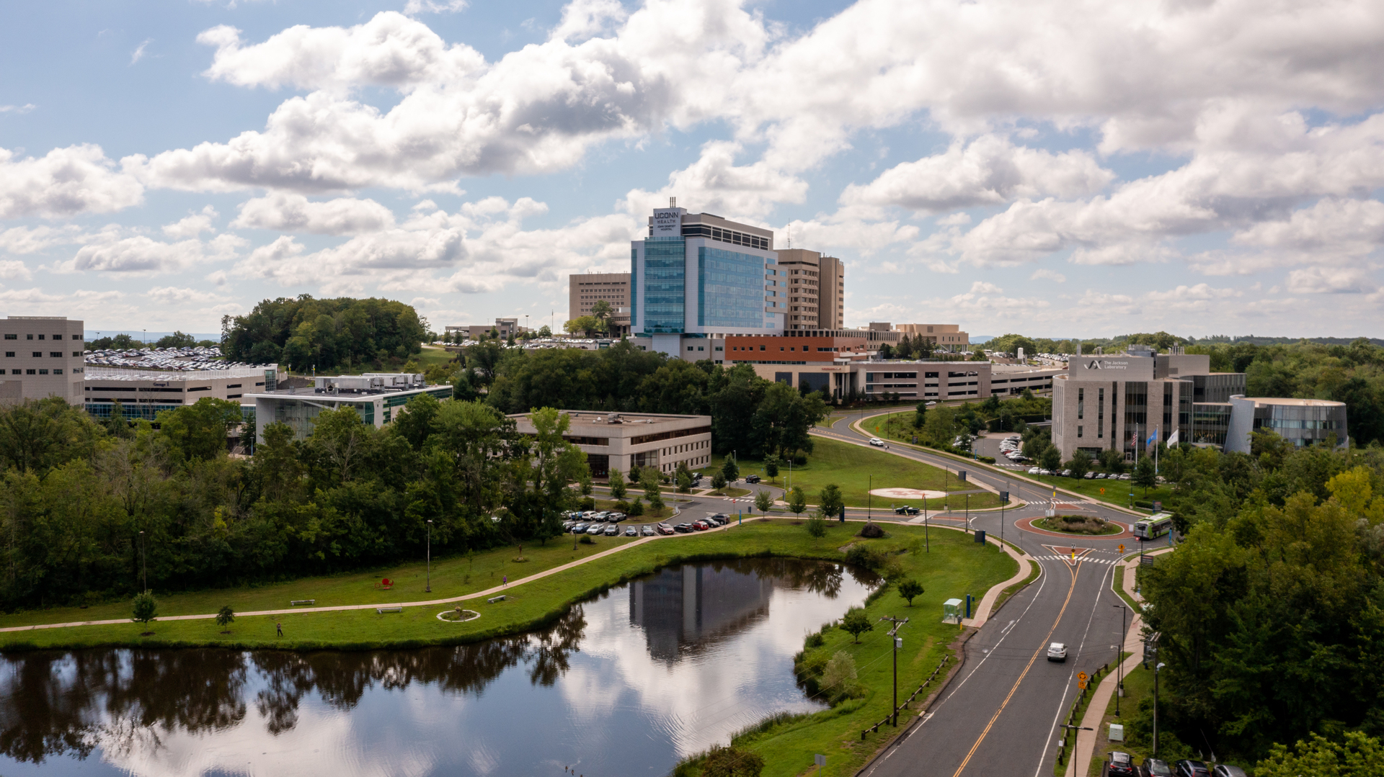
UConn Health CEO Report
Board of Trustees
February 25, 2026

Slide 2



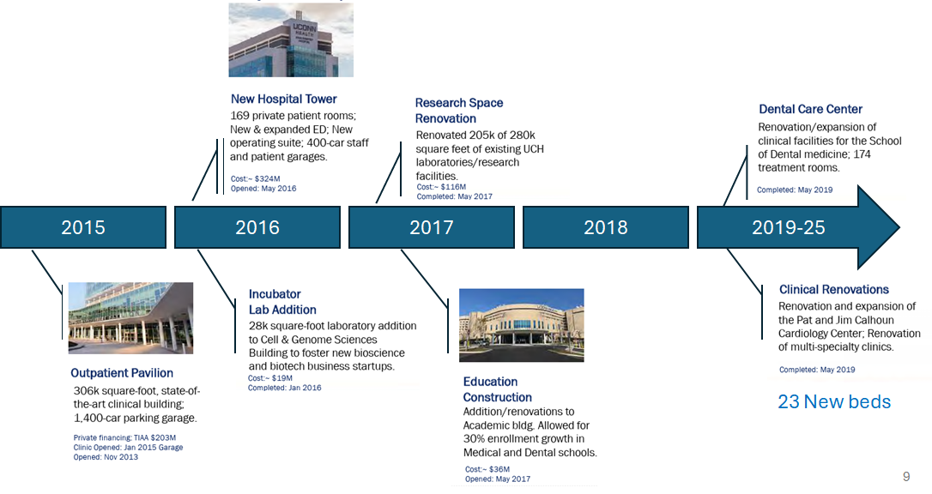
History in the Making
2026: The UConn Health
Community Network
Quality
Waterbury Health:
-Access
-Quality
-Service to the community
Net Patient Revenues. 2015: 430.3 Million 2026: 1.2 Billion
School of Medicine. 2018: 409 Students 2024: 444 Students
Growth
School of Dental Med. 2018: 186 Students 2024: 204 Students
UConn Health:
-Scale
-Capacity
-Financial growth
-Service to more residents
Infrastructure
Excellence
The State:
-Access
-Economy
-Aligned ownership
-Alternative system

Slide 3
Milestones Since November 2025
Milestones | Date
Complete
UConn Health Bid Submitted | 11/11/25
State Funding Approved | 11/13/25
Integration Kick off | 12/02/25
Certificate of Need (CON) Public Hearing | 12/19/25
Waterbury Leadership Town Hall | 01/14/2026
CON Approval | 01/30/2026
Upcoming
Waterbury Transaction Closes* | 02/28/26

Slide 4
Integration Management Office: 250+ Workstreams
Provider Council
Executive Steering Committee (ESC)
IMO Advisory Council
UCHC Members: Executive Leader, CEO – Dr. Andrew Agwunobi
EYP Advisors: Adam Sorensen, Andy Bechtel, Mike India
(Meets weekly)
Waterbury Health leadership (Advisory)
Members:
Group of key influential physicians from UConn Health, Day Kimball, Bristol and Waterbury
EYP UConn Health Account Exec.
Jeff Vincequere
Integration Management Office (IMO)
IMO Leaders (UConn Health):
EYP IMO: Vic Shah, Shriya Gupta, Brianna Dacey (Meets daily)
Cross functional IMO teams
Network, Clinical Services & Growth
TSAs, Value Creation & Integration Costs
Culture, Change Mgmt. & Comms
EYP Lead:
Dr. Matt Weiss
EYP Lead: Steve Bussey
EYP Lead:
Herb Jackson
Physician Enterprise
Research & Teaching
Real Estate & Facilities
Clinical Quality
Clinical and Ancillary
Revenue Cycle Management & Managed Care
Finance & Accounting
Supply Chain & Contracting
Information Technology
Human Resources
Marketing & Comms
Other
Admin¹
Matt Weiss, Kristen Peck
Kristen Peck
Vic Shah
Matt Weiss, Kristen Peck
Matt Weiss, Kristen Peck
Andrew Gentile
Kevin Brintnall
Chris Windfelder
Tony Kong
Herb Jackson
Shriya Gupta
Vic Shah
UConn
Waterbury
EY
¹[To be defined – legal and other workstreams based on leadership discussions]

Slide 5
Executive Summary: On Track for Close on Feb 28
We are 3 days from close and there has been significant progress over the past week on several fronts:
The majority of employee and provider offer letters have been signed (as of 12/18)
Signed direct contracts with several critical vendors
Employee benefits are finalized
Obtained med mal insurance coverage for physicians in February
Approval and access to conduct cyber assessment
Hypercare and Incident Command Center plans are in place for Day 1 and beyond
There are still several outstanding Day 1 requirements in process but nothing preventing close. These include:
Completing employee onboarding, including plans for in-person physicals
Finalizing some TSA agreements
Obtaining agreement from payers to bill under PMH contracts

Slide 6
Waterbury Closing Timeline
Friday 2/27
“Soft Close”
Closing documents signed
Regulatory / license, employee & bankruptcy matters complete
Saturday 2/28
“Close Date”
Official close date
Preparation for IT cutovers (including access, printers, badges, etc.)
Hypercare support and ticketing process opens at Waterbury
Sunday 3/1
“Day 1”
Assets and employees transition to UConn Health Waterbury new legal entities at 12:01am
Signage installation and facility improvements underway
Leadership rounding
Monday 3/2
“Opening Day”
Passive benefits enrollment for employees completed; active enrollment period begins
Public announcements including patient letters and press release

Slide 7
Key Priorities for UConn Health Waterbury include:
Stabilize operations through close
Ensure continued and enhanced clinical quality
Welcome the community to the new UConn Health Waterbury hospital
Integrate culture and workforce
Assess and enhance infrastructure
Expand and grow service lines
Improve Financial Performance
Strengthen brand and market presence

Slide 8
Thank You

