Slide 1


President’s Update
Dr. Radenka Maric
Board of Trustees Meeting
25 February 2026

Slide 2

UConn’s Operational Priorities
Improving our enrollment outlook
Continuous improvement & enterprise effectiveness
Increasing our academic & research profile
Supporting a championship culture and competitiveness in athletics
Advancing fundraising efforts and engagement at the Foundation

Slide 3

1. Improving our Enrollment Outlook
Focus on enrollment and student success

Slide 4
Fall-to-Spring Retention, Past 5 Years
First Year Full-Time Undergraduate Bachelor Seeking, All Campuses (Storrs + Regionals)
Status as of Following Spring Semester | Fall 2021 | Fall 2022 | Fall 2023 | Fall 2024 | Fall 2025
Retained | 5,136 | 5,450 | 5,486 | 6,127 | 6,128
Not Retained | 252 | 243 | 210 | 248 | 261
Exclusion* | 3 | 6 | 5 | 0 | 9
Total Number of Undergraduates | 5,391 | 5,699 | 5,701 | 6,375 | 6,398
Adjusted Cohort (remove exclusions) | 5,136 | 5,699 | 5,701 | 6,375 | 6,389
Percentage Retained out of Adjusted Total | 95.3% | 95.7% | 96.3% | 96.1% | 95.9%
All Undergraduate Bachelor Seeking, All Campuses (Storrs + Regionals, Full-Time & Part-Time)
Status as of Following Spring Semester | Fall 2021 | Fall 2022 | Fall 2023 | Fall 2024 | Fall 2025
Retained | 21,539 | 21,812 | 22,230 | 23,163 | 23,912
Not Retained | 1,107 | 1,054 | 931 | 985 | 1,058
Completions/ Graduations | 788 | 797 | 755 | 731 | 773
Exclusion* | 11 | 16 | 11 | 4 | 22
Total Number of Undergraduates | 23,445 | 23,679 | 23,927 | 24,883 | 25,765
Adjusted Cohort (Remove Graduations & Exclusions) | 22,646 | 22,866 | 23,161 | 24,148 | 24,970
Percentage of Undergraduates Retained | 95.1% | 95.4% | 96.0% | 95.9% | 95.8%

Slide 5
Undergraduate and Graduate Financial Aid
(in $ millions)
 | FY22 | FY23 | FY24 | FY25 | FY26 | FY22-FY26 Change
 |  |  |  |  | Est.
1st Generation Students (associate, bachelor and undergrad non-degree only) | 7,321 | 8,220 | 8,426 | 8,744 | 8,913 | 22%
University Supported* | $163.8 | $169.4 | $197.7 | $214.0 | $232.4 | 42%
Federal (Pell/SEOG) | $74.5 | $47.1 | $59.5 | $68.4 | $57.9 | -22%
Other*** | $20.9 | $32.1 | $25.8 | $30.1 | $35.0 | 67%
State (includes R. Willis Scholarship)** | $9.9 | $10.5 | $5.0 | $11.4 | $8.2 | -17%
Total Aid | $269.1 | $259.1 | $288.1 | $323.9 | $333.6 | 24%
*University-supported aid includes undergraduate and graduate aid funded by tuition, departmental revenue, and work-study.
**Other funding comes from the private sources such as the Foundation and endowments.
***State ARPA funds were added to the R.Willis Scholarship program in FY23-FY25.

Slide 6
Number of First Generation Students vs.
Non-First Generation Students, Past 5 Years
(Source: BPIR Dashboard)

Slide 7
Percentage of Students
Who Stay in CT After Graduation, Past 5 Years
(Source: Career Readiness)
2021
2022
2023
2024
2025

Slide 8

2. Continuous Improvement and
Enterprise Effectiveness
Focus on campus infrastructure and safety

Slide 9
Gant Science Complex Renovations
Phase 3 (2027)
North Wing
~ 104,000 GSF
Phase 1 (2019)
South Wing
Central Plaza
(Light Court)
~ 78,000 GSF
$278.5M total project budget
Largest, most heavily used building on campus
Comprises ~ 310,000 gross square feet
Teaching and research workhorse since early 1970s
Building renovations in three phases:
  Phase 1 (Physics)
  Phase 2 (PNB, MCB, EEB)
  Phase 3 (Biology class labs, various departmental spaces, two floors of shell space)
Phase 2 (2021)
West Wing
~ 126,000 GSF

Slide 10
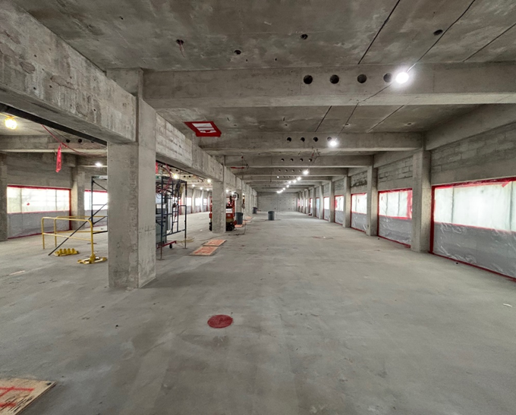
Gant Science Complex Renovations
Phase 3 mobilized in June 2025
Current construction cost is $103M
Approximately 25% complete
Tracking on-time for December 2027 and under the total project budget
Current activities include:
  Demolition of interior walls and finishes
  Removal of outdated building systems
  Abatement of regulated materials
  Demolition of existing roof for construction of new fourth floor
  Preparation for masonry repairs and window replacements
  Exterior utility installation
Phase 3 | 3rd Floor Demolition

Slide 11
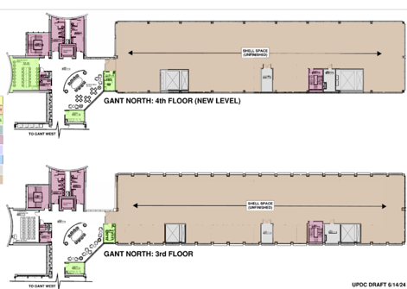
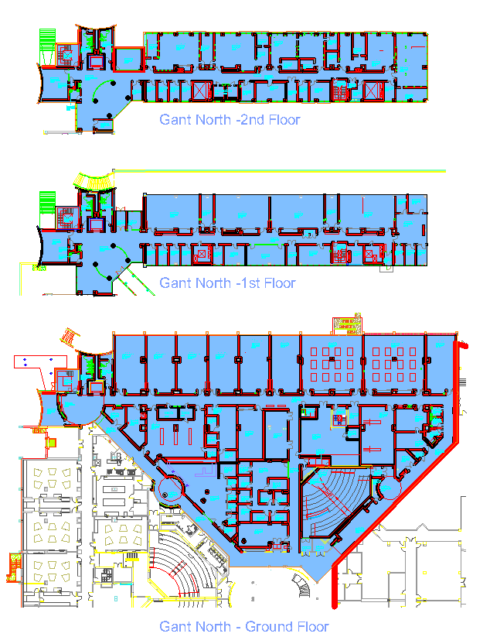
Gant Science
Complex Renovations
FOURTH FLOOR (NEW LEVEL)
Shell Space (16,000 GSF)
THIRD FLOOR
Shell Space (16,000 GSF)
When complete, Phase 3 will have renovated approximately 104,000 gross square feet
of space
Renovated areas will include, but are not limited to:
  (20) class labs & classrooms with adjoining lab supplies and lab support spaces
  148-person lecture hall
  CLAS tutoring center and advising space
  (5) dedicated tutoring rooms
  (27) shared & individual offices
  (8) meeting rooms
  (2) floors of shell space with enabling infrastructure for future research-based,
  fit-outs
SECOND FLOOR
Teaching Labs, Offices & Support (BIO)
FIRST FLOOR
Teaching Labs, Offices & Support (EEB)
GROUND FLOOR
Teaching Labs & Support (BIO)
Classrooms
ITS Workspace
Supply Room
Advising & Tutoring (CLAS)
148-person Lecture Hall

Slide 12

Gant Science Complex Renovations
When this final phase is complete, as much as 75% of assigned space in Torrey Life Sciences Building will be vacated.
Phase 3 Exterior
Southeast Corner

Slide 13
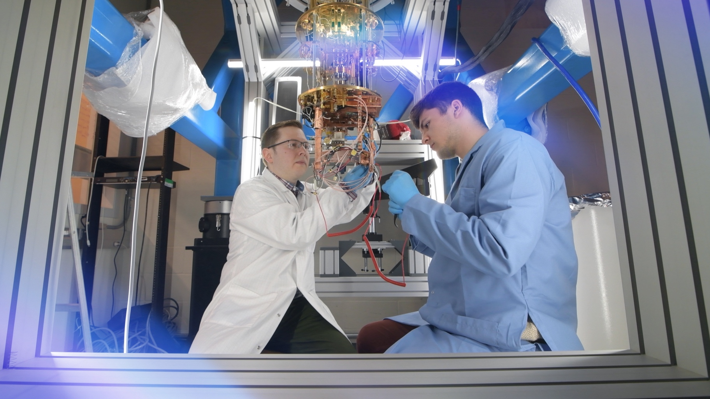
3. Increase Our Academic and Research Profile
Focus on signature research initiatives & rankings
Notes:
Focusing on Signature Research Initiatives and Rankings

Slide 14




Signature research initiatives
Department of Energy Genesis Mission
A National Mission to Accelerate Science through Artificial Intelligence
National Science and Technology Focus Areas:
Energy:
Fusion
Nuclear
Grid
Discovery Science:
    Molecules
    Particles
    Quantum
National Security:
Securing Critical Materials
Discovering Mission-Ready Materials
Advanced Manufacturing
  UConn Areas of Strength: UConn is competitive in the focus areas outlined above.
Notes:
Goal: Genesis Mission will develop an integrated platform that connects the world’s best supercomputers, experimental facilities, AI systems, and unique datasets across every major scientific domain to double the productivity and impact of American research and innovation within a decade.

Slide 15
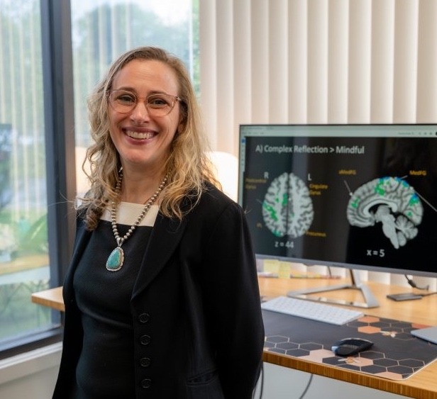
Husky Pride:
Recognition and
Reputation
Faculty excellence across UConn’s schools and colleges drives improvement in rankings and elevates reputation.
Just one example of the many prestigious honors earned by our faculty: Dr. Sarah Feldstein Ewing was elected in January 2026 to membership in the American College of Neuropsychopharmacology.
Dr. Ewing serves as professor of psychiatry, vice chair for research, and Health Net Inc. Chair in Alcohol and Substance Abuse in the UConn School of Medicine
Notes:
American College of Neuropsychopharmacology Elects UConn’s Sarah Feldstein Ewing, Ph.D. https://today.uconn.edu/2026/01/american-college-of-neuropsychopharmacology-elects-uconns-sarah-feldstein-ewing-ph-d/

Slide 16


New ranking places UConn in top 23% of global universities
UConn Rank:
#111
out of 500 universities worldwide
Ranking Criteria:
Academic capacity & performance
Innovation & economic impact
Global engagement
Notes:
Universities were shortlisted if they met at least one of the following conditions:
At least one of the highly cited researchers, according to Clarivate, is among their faculty,
They are among the most renowned and frequently mentioned institutions, or
They applied through the open call to action published on TIME.com.
The analysis is structured around three key pillars: academic capacity & performance, innovation & economic impact, and global engagement. Institutions receive scores on each pillar, which are then aggregated into a final score used to produce the ranking.
The ranking acknowledges key limitations in global university comparisons. Given uneven reporting across countries, the Statista R team triangulated international, national, and university-supplied data to improve consistency. The study assesses many outputs relative to institutional inputs or country averages to reduce bias from differing contexts.
Accordingly, the study incorporates regional and national factors to contextualize academic performance and account for institutional starting positions, extending beyond purchasing power parity (PPP) to include additional relevant factors.
The framework of academic capacity & performance, innovation & economic impact, and global engagement retains the classical components used in higher education assessments, such as the learning environment and academic output, while integrating measures of societal and economic impact and the international reach of institutions.
In addition, Statista R places particular emphasis on indicators that link universities to real-world innovation, labor-market outcomes, and internationalization. These pillars are operationalized through a broad set of quantitative indicators derived from global and national datasets as well as institutional submissions, which are normalized and aggregated according to a transparent weighting scheme. The three pillars are weighted as follows in the overall scoring model: 60% academic capacity & performance, 30% innovation & economic impact, and 10% global engagement.

Slide 17

4. Supporting a Championship Culture and Competitiveness in Athletics
Focus on investing in athletics
Notes:
Focusing on Signature Research Initiatives and Rankings

Slide 18
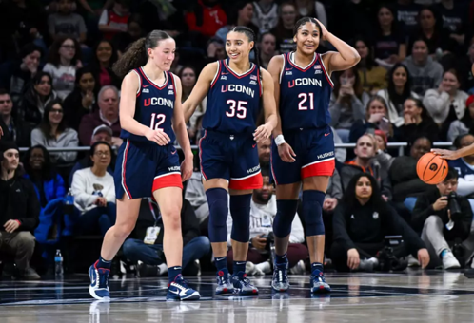

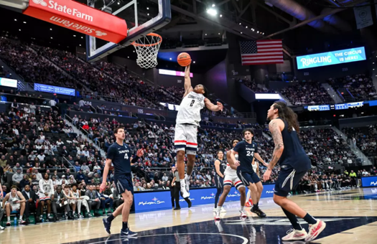

Athletics Update
Revenue Outlook
Athletics is on track to meet or exceed revenue goals set for FY26.
Conversations are progressing regarding adding another name to Gampel Pavilion.
The NCAA has approved the future use of commercial patches that may be placed on uniforms for advertising purposes. We are exploring offering this opportunity to interested parties.
The College Football Playoff recently met and discussed the unequal revenue distribution that we are currently receiving as an independent football program. The goal would be to get a share equal to that of our current peers in the G6.
Championship Culture
Men’s and Women’s Basketball and Men’s and Women’s Ice Hockey have all been ranked in the top 10 during the regular season.
For the first time, all these teams have the potential to qualify for the NCAA tournament in the same year.

Slide 19
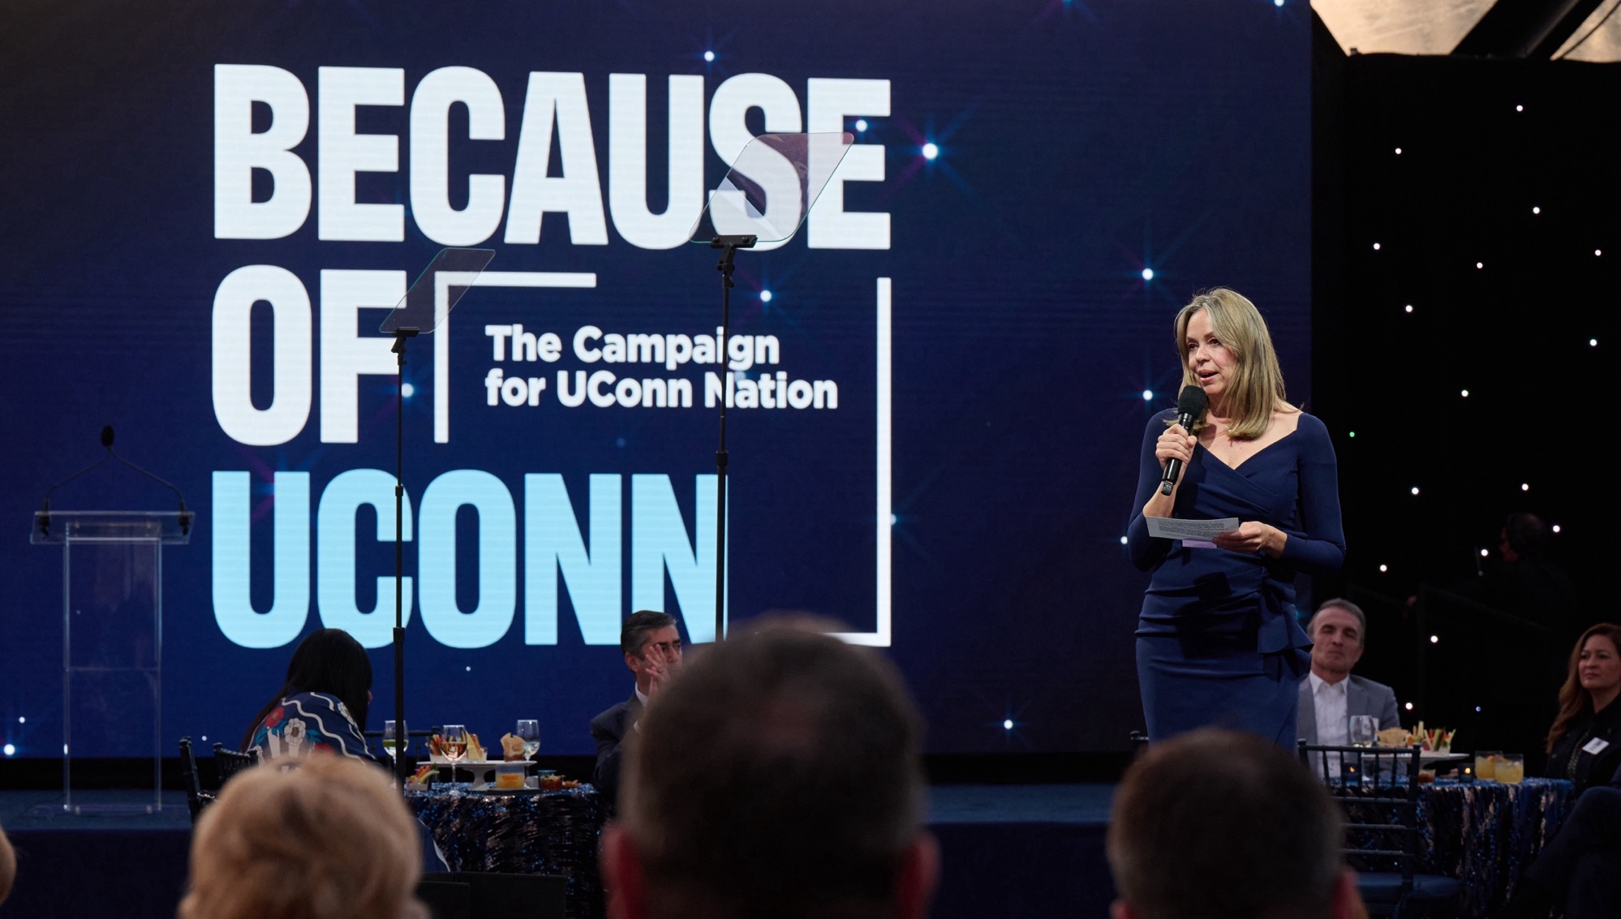
5. Advancing Fundraising Efforts and Engagement at the Foundation

Slide 20

An $11M Gift from the Goldenson Family Advances Research and Education in Actuarial Sciences
“The idea of providing experiential education to students in actuarial applied research is important to our family, so further investment in the Center was an easy decision for us,”
Mark Goldenson,
pictured to the left with his wife, Janet Vadiveloo.
The Goldenson Center for Actuarial Research strives to provide high-quality actuarial research projects and services to support the insurance and financial services industry in our region.

Slide 21
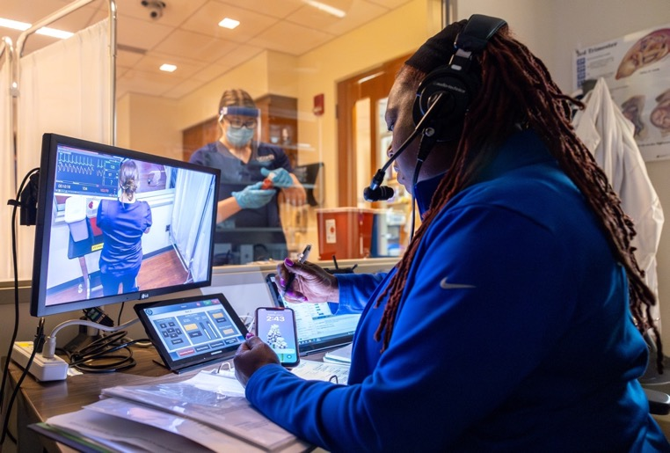
$10M* in New Funds from the DeLuca Foundation
Opens Doors for Waterbury Students
*This new gift includes $1.65M in matching funds aimed at drawing new donors and additional investment in UConn Waterbury.
Supported by this gift, UConn launches three initiatives at Waterbury to expand access to nursing education and strengthen Connecticut’s healthcare workforce.
$5M Nursing at Waterbury Pathway supports nursing students at Waterbury in their early years and transitions them to Deluca Hall at Storrs in their junior and senior years
$5.45M STEM Investment:
  Husky Prep Academy supports Waterbury public high school students by creating a health/STEM pathway to UConn Waterbury, college credit, and hands-on learning.
  Ideas to Action (I2A) Lab, introduces students to health and STEM careers through hands-on activities
UConn nursing students participate in a simulation in the nursing simulation lab in Storrs Hall
Notes:
The University of Connecticut will launch three bold initiatives at UConn Waterbury, offering early college opportunities for Waterbury high school students, a new Waterbury campus pathway for nursing students, and innovative STEM experiences. Made possible by transformational investments from the Elisabeth C. DeLuca Foundation, these combined efforts will expand college access, accelerate student success, and address critical workforce shortages in nursing and STEM fields across the state.

Slide 22
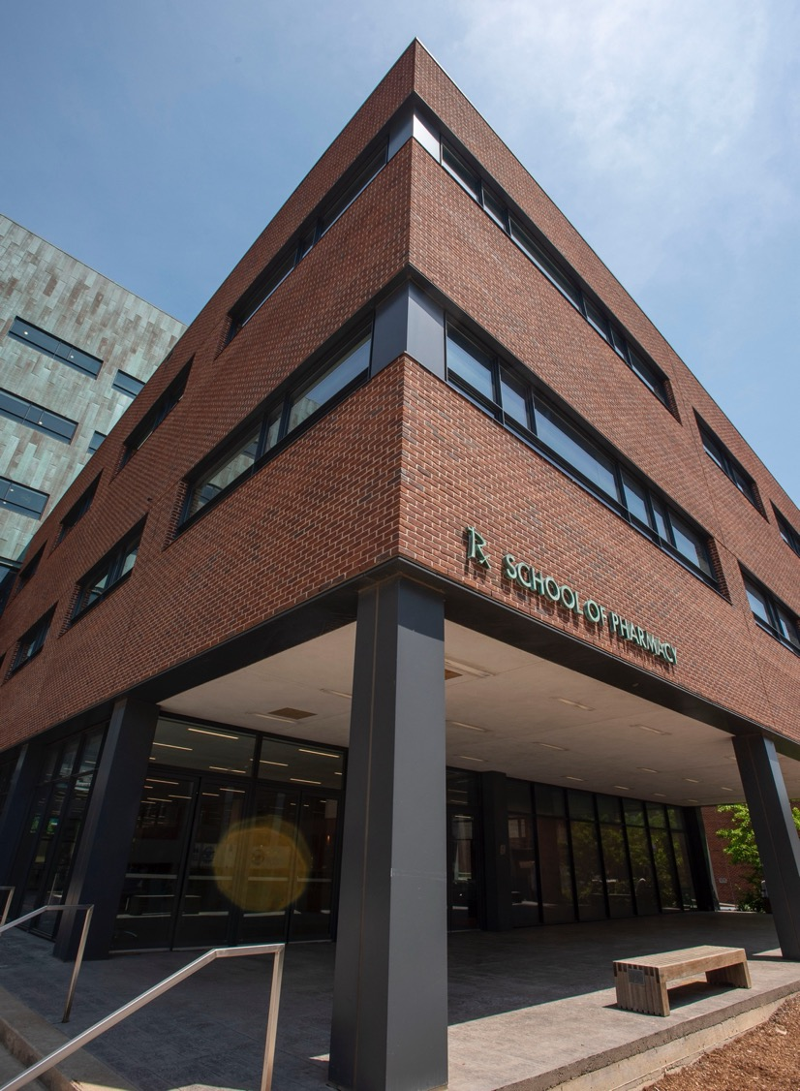
$250,000 Gift to School of Pharmacy Targets Innovation in Non-Animal Testing
The gift establishes:
The Jane Hirsh Fellowship in Non-Animal Testing Innovation, which directly supports pharmacy graduate students pursuing alternatives to animal testing in medical therapy development
The Hirsh Fund for Non-Animal Testing Innovation Programs, which funds research in non-animal testing methods, including organ-on-a-chip technology. Organ-on-a-chip devices are lined with living human cells and are used to detect human organ responses

Slide 23


Thank you!

